Slide 1
Terrestrial Ecosystem Models

Slide 2


Slide 3
Different types of models
Land surface models
Terrestrial biosphere models
Terrestrial ecosystem models
Dynamic vegetation models
General circulation models
Earth system models

Slide 4
Different types of models
Land surface models
Terrestrial biosphere models
Terrestrial ecosystem models
Dynamic vegetation models
General circulation models
Earth system models
Generally thought of to be the same thing:
“numerical models that solve the coupled fluxes of water, energy, and carbon between the land surface and atmosphere, within a context of direct and indirect human forcings and ecological dynamics” (Fisher and Koven, 2020)

Slide 5
Different types of models
Land surface models
Terrestrial biosphere models
Terrestrial ecosystem models
Dynamic vegetation models
General circulation models
Earth system models
A type of land surface model where the type of vegetation in a given location can change

Slide 6
Different types of models
Land surface models
Terrestrial biosphere models
Terrestrial ecosystem models
Dynamic vegetation models
General circulation models
Earth system models
Models of atmospheric pools and fluxes used to predict climate dynamics

Slide 7
Different types of models
Land surface models
Terrestrial biosphere models
Terrestrial ecosystem models
Dynamic vegetation models
General circulation models
Earth system models
A model that couples together models of different components of the Earth system (e.g., land, ocean, atmosphere, sea ice, etc.)

Slide 8
This class will focus on land surface/terrestrial biosphere/terrestrial ecosystem models
Land surface models
Terrestrial biosphere models
Terrestrial ecosystem models
Dynamic vegetation models
General circulation models
Earth system models
“numerical models that solve the coupled fluxes of water, energy, and carbon between the land surface and atmosphere, within a context of direct and indirect human forcings and ecological dynamics” (Fisher and Koven, 2020)

Slide 9
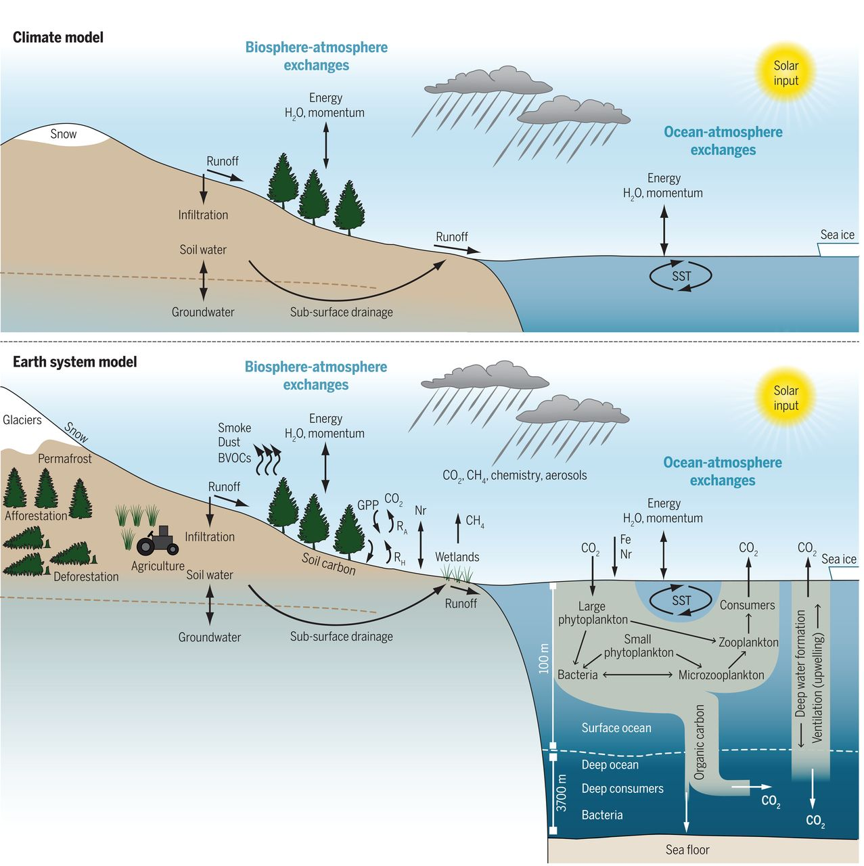
Bonan and Doney (2018)

Slide 10
Why were these models originally developed?
Plant biophysical responses have an appreciable effect on climate
Terrestrial biogeochemical responses have an appreciable effect on climate through their impact on the carbon cycle

Slide 11
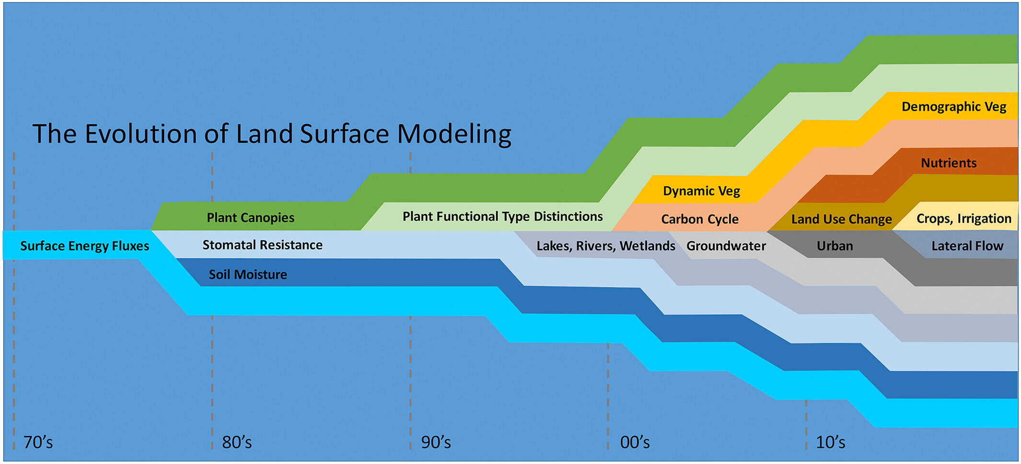
Fisher and Koven (2020)

Slide 12
How do these influence biophysical and biogeochemical processes?
Fisher and Koven (2020)

Slide 13
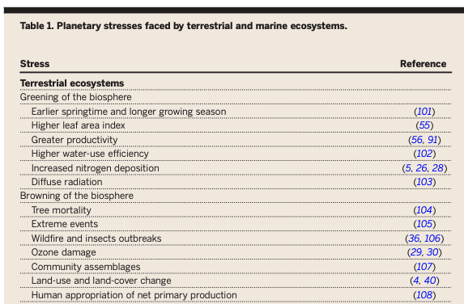
Bonan and Doney (2018)

Slide 14
Fisher and Koven’s 3 grand challenges
Managing and understanding process complexity
Heterogeneity and the dimensionality of the land surface
Projecting the temporal and spatial dynamics of model parameters

Slide 15
Fisher and Koven’s 3 grand challenges
Managing and understanding process complexity
Heterogeneity and the dimensionality of the land surface
Projecting the temporal and spatial dynamics of model parameters

Slide 16
“the scope and complexity of land surface models have reached the point that no individuals are able to comprehensively understand all facets of any one model”

Slide 17
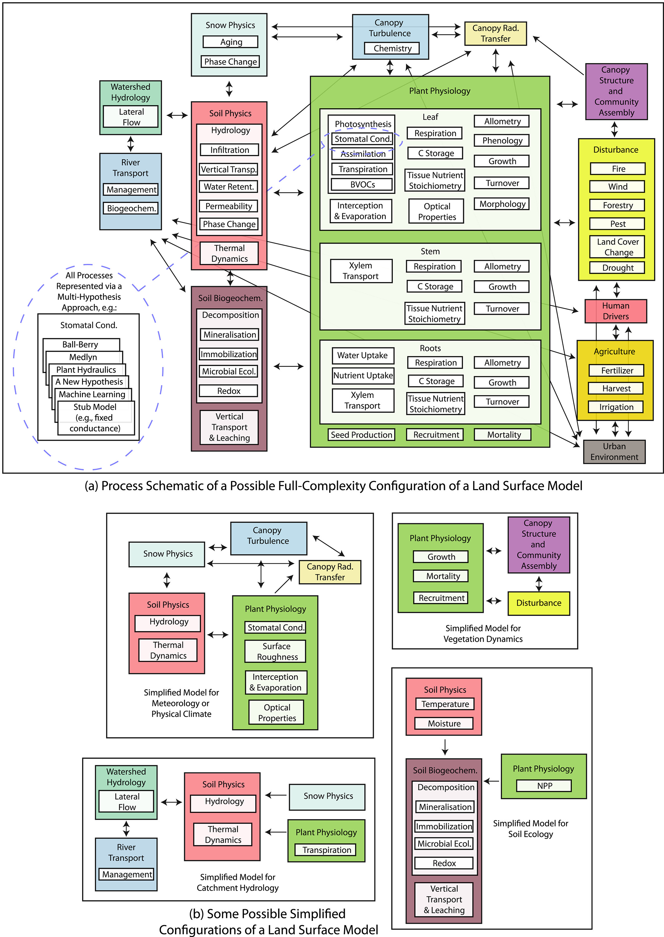
Modular complexity as a strategy for understanding models
Fisher and Koven (2020)

Slide 18
Fisher and Koven (2020)

Slide 19
Fisher and Koven’s 3 grand challenges
Managing and understanding process complexity
Heterogeneity and the dimensionality of the land surface
Projecting the temporal and spatial dynamics of model parameters

Slide 20
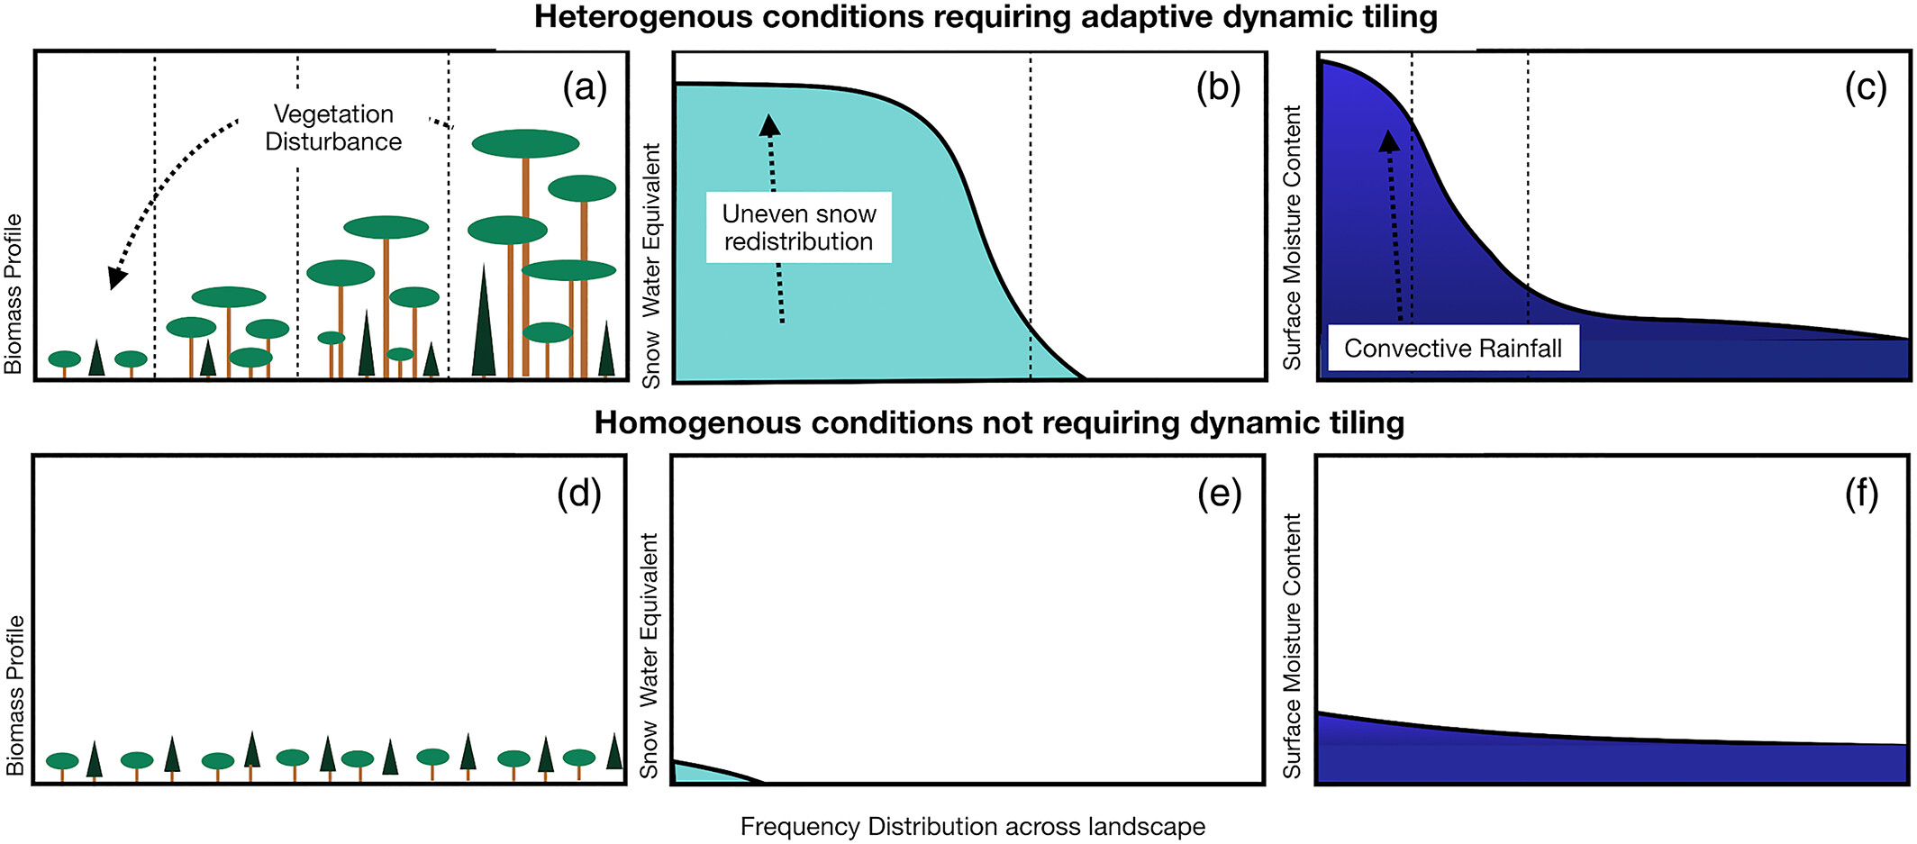
Fisher and Koven (2020)

Slide 21
Fisher and Koven’s 3 grand challenges
Managing and understanding process complexity
Heterogeneity and the dimensionality of the land surface
Projecting the temporal and spatial dynamics of model parameters

Slide 22
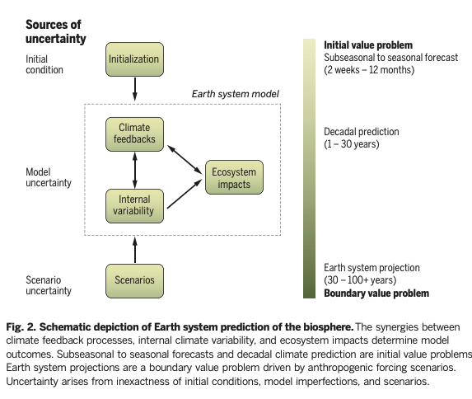
Bonan and Doney (2018)

Slide 23
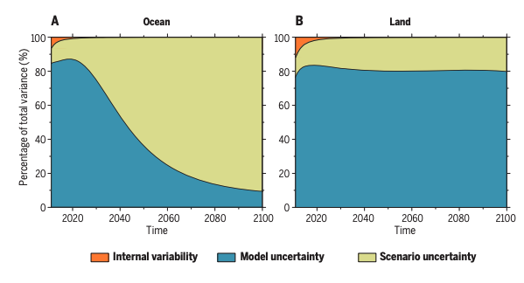
Bonan and Doney (2018)

Slide 24
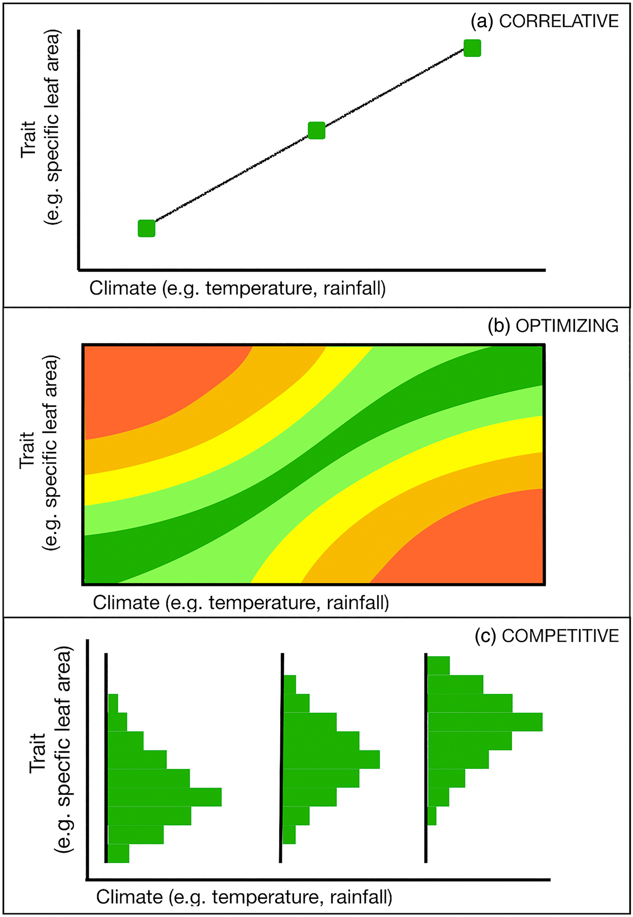
Fisher and Koven (2020)

Slide 25
In this class, we’re taking a slightly different approach than “typical modelers”
We’re starting from scratch to build a model from the beginning
What are the positives/negatives of this approach?

